Slide 1
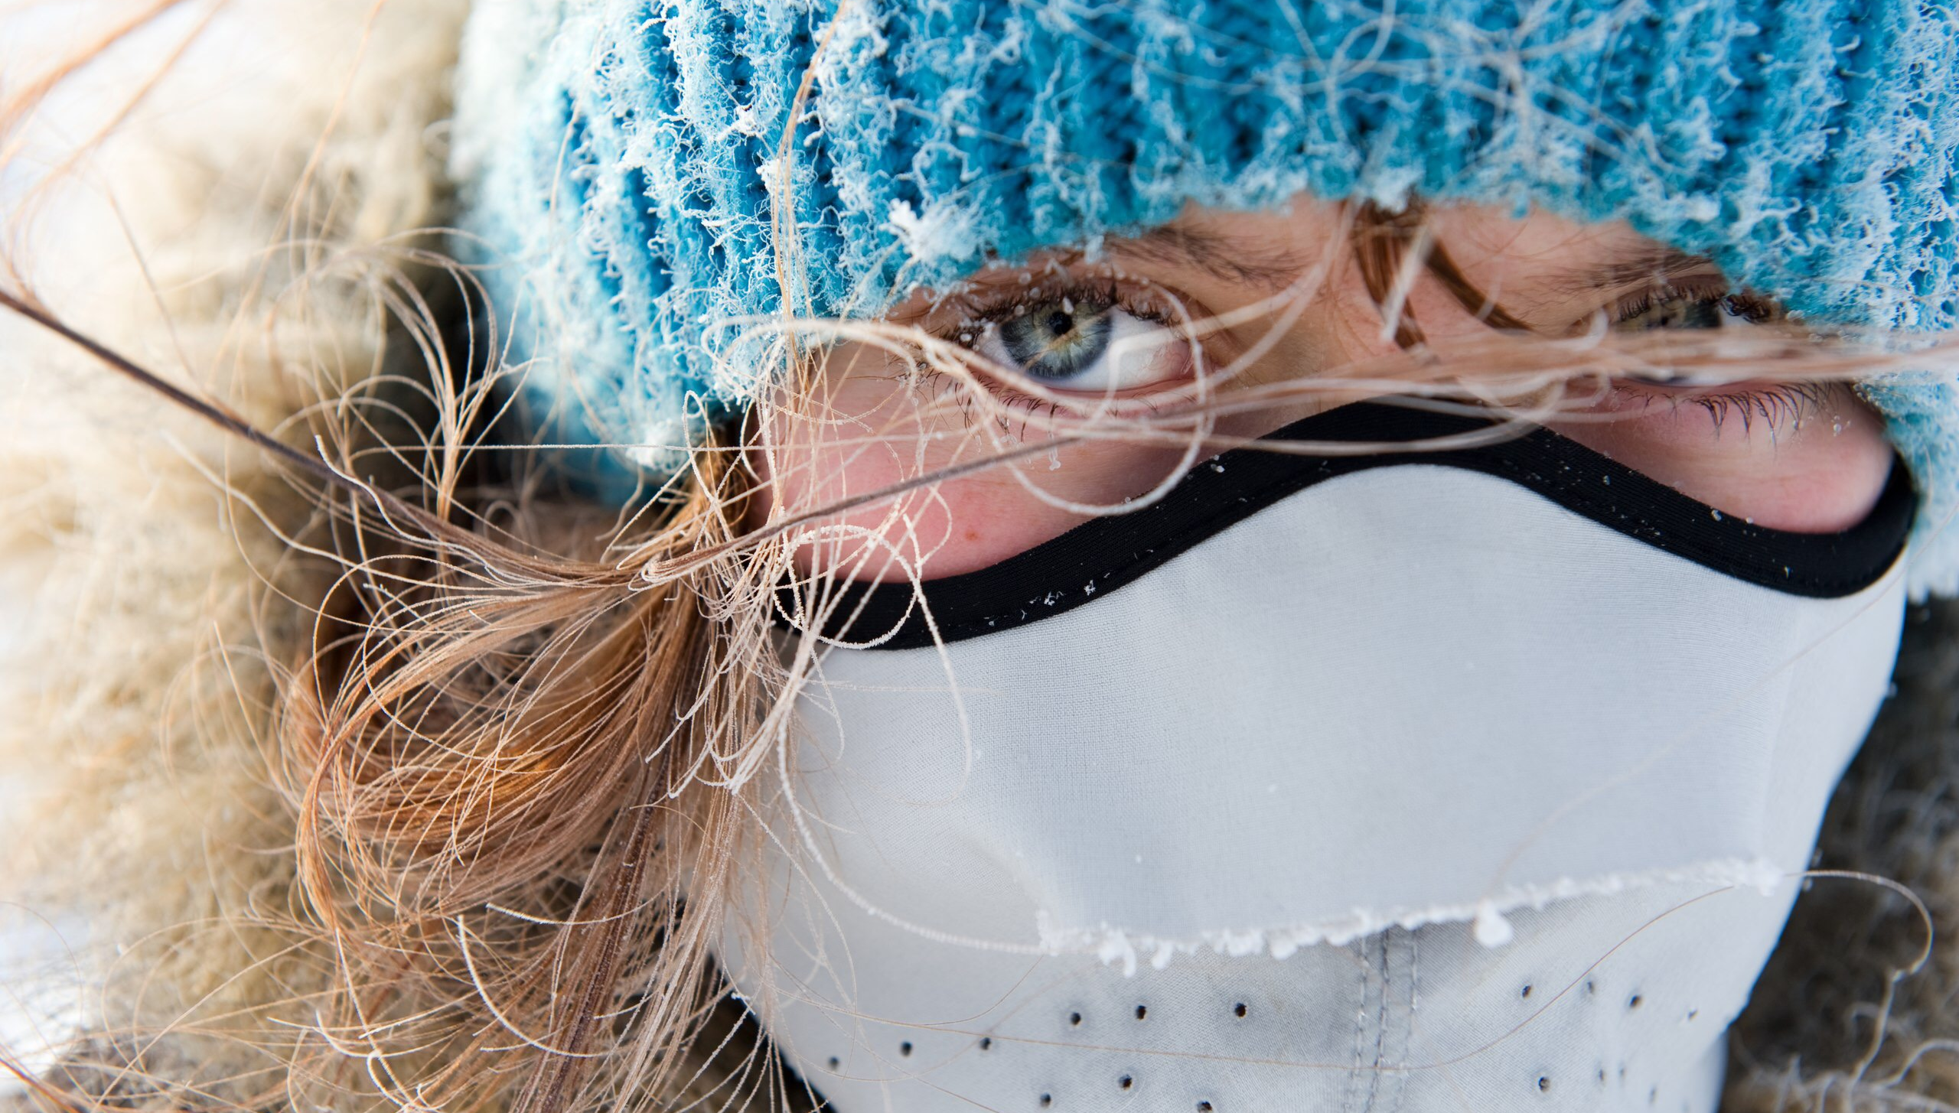
PERSONAL SUSTAINABILITY
From Siberia with Love

Slide 2
“…A person is sustainable if he takes care of himself and maintains a reasonable level of energy and spirit…”

Slide 3
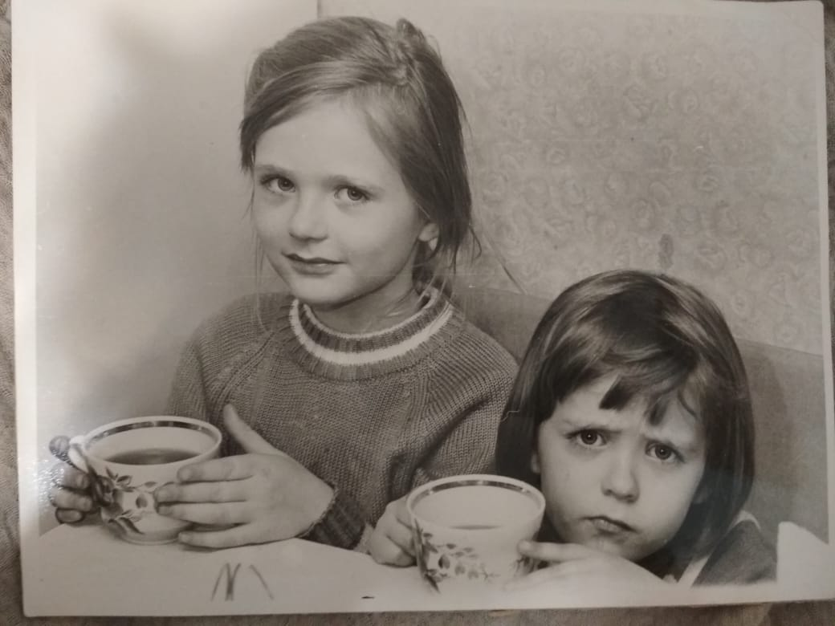
I when I was 4

Slide 4
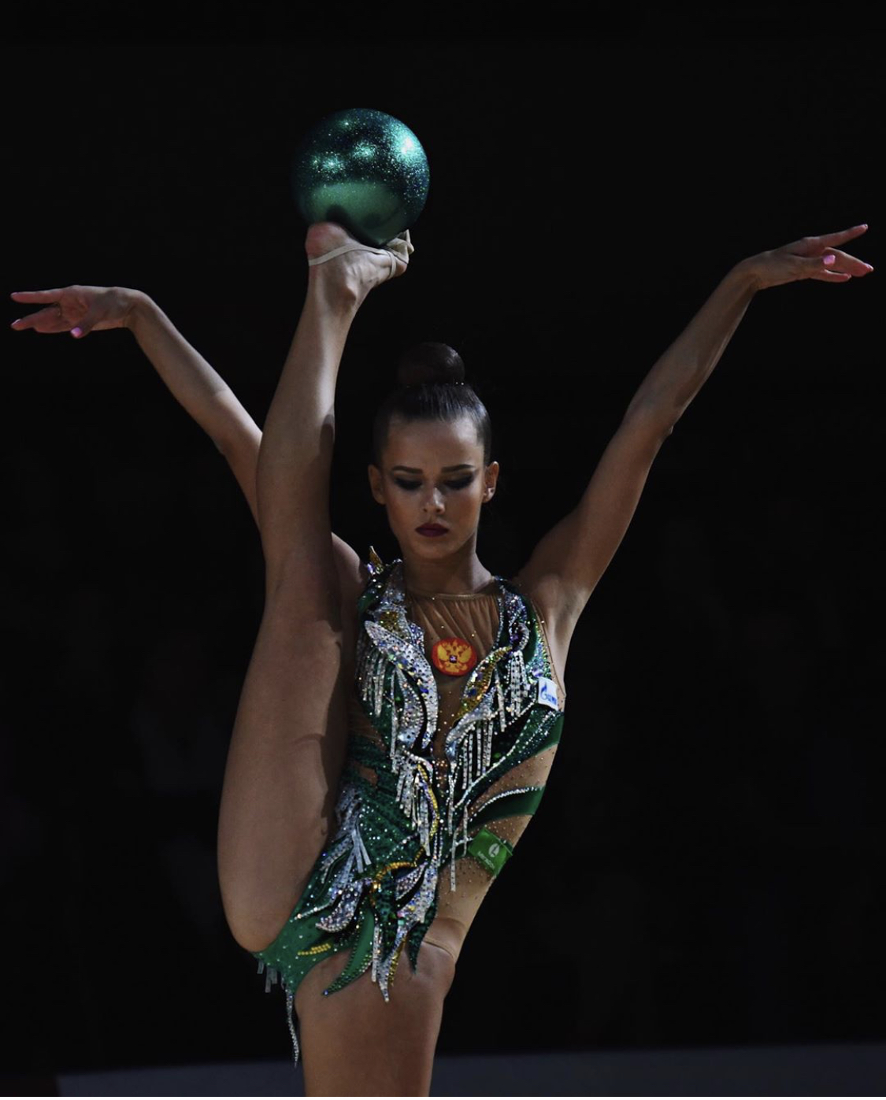
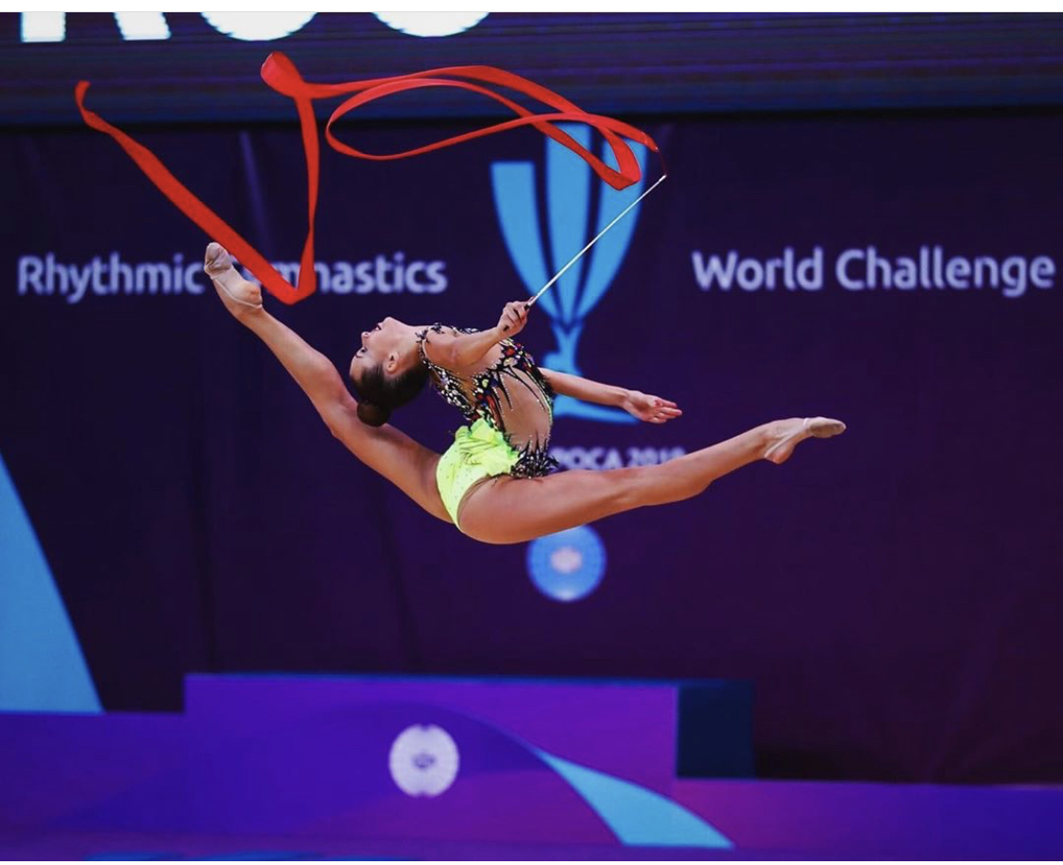

Slide 5
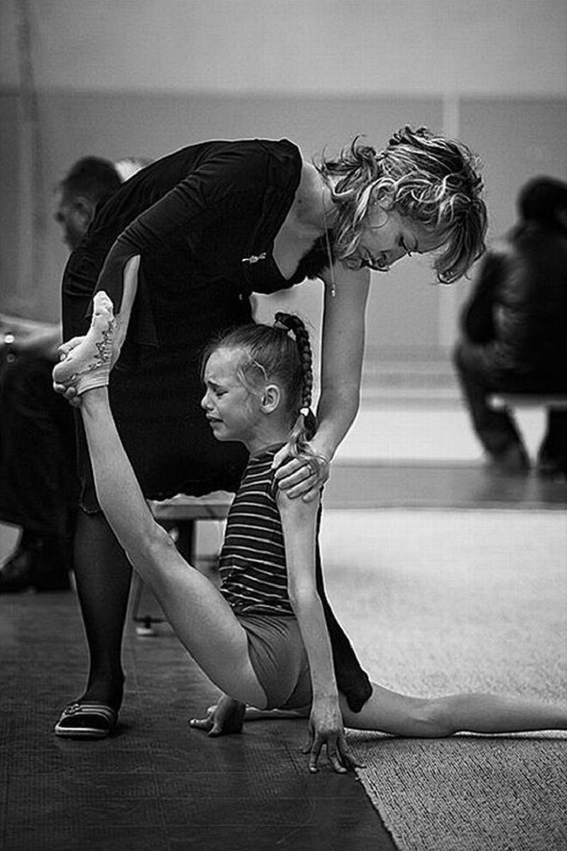
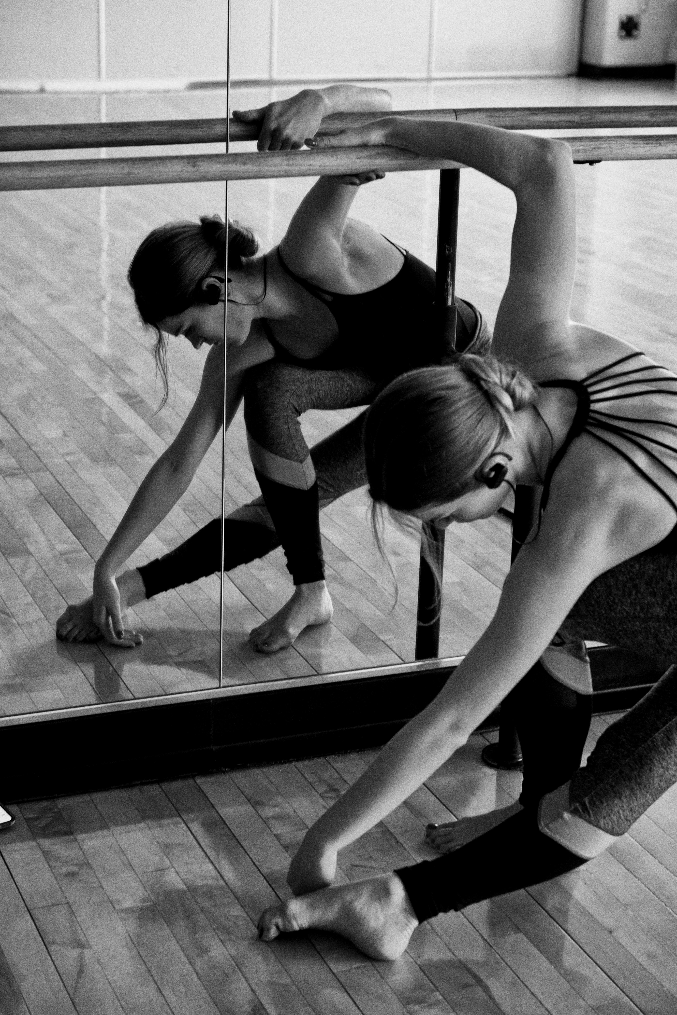
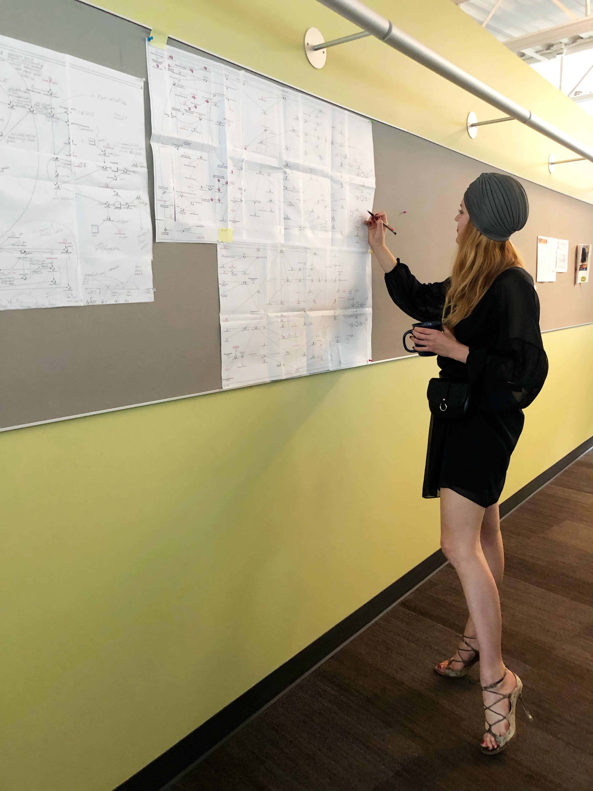
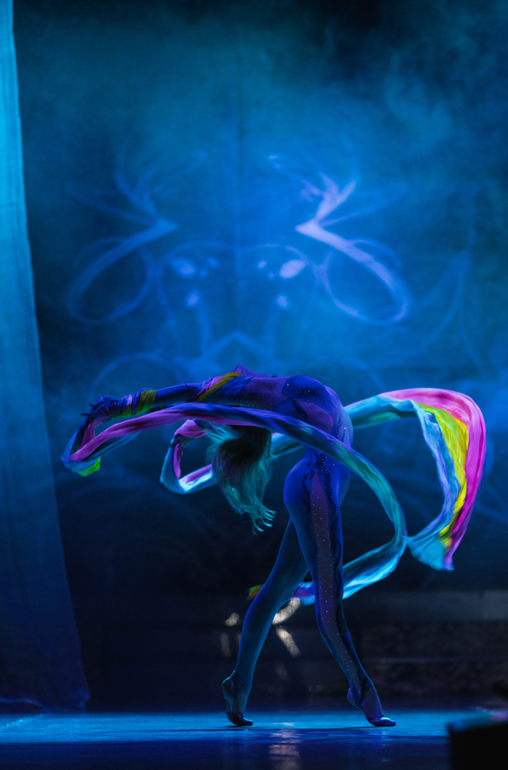
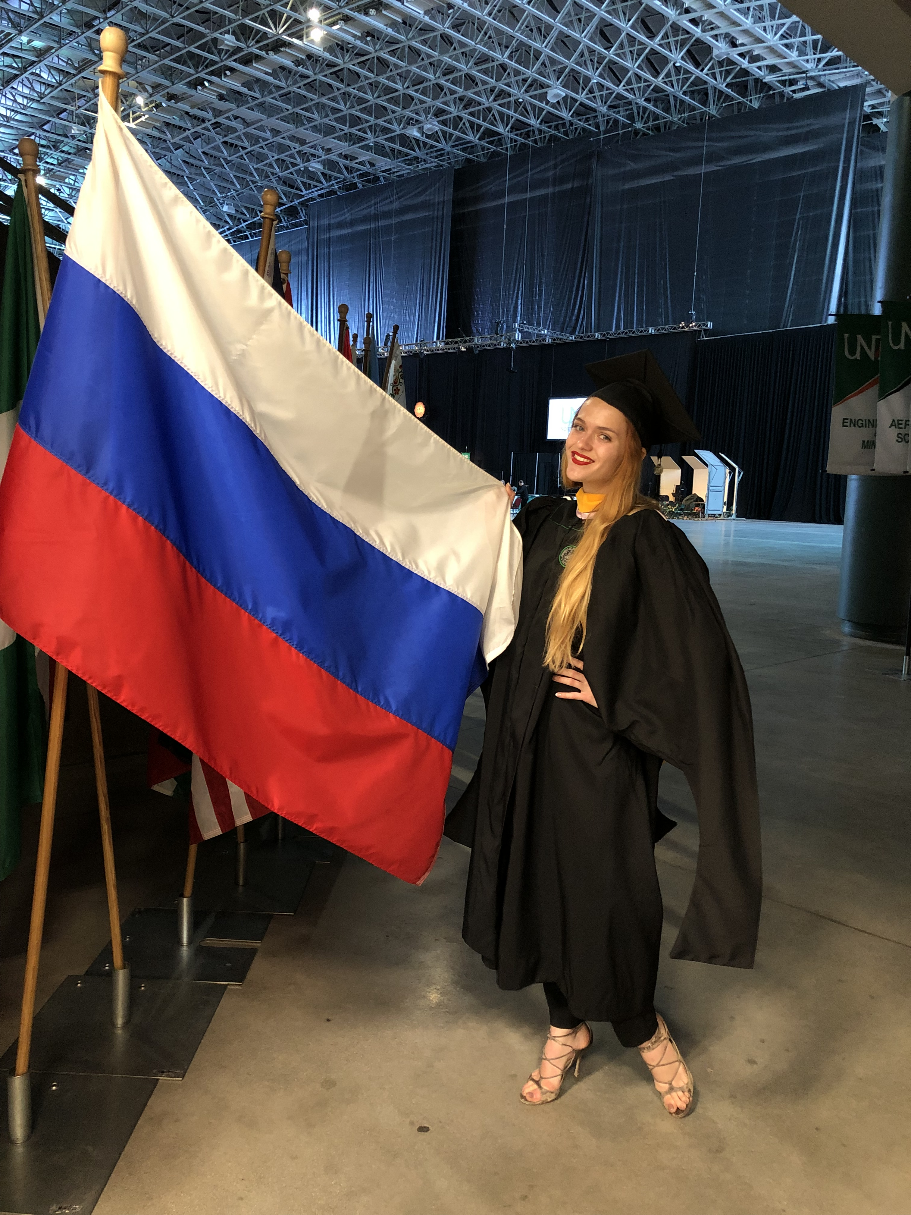
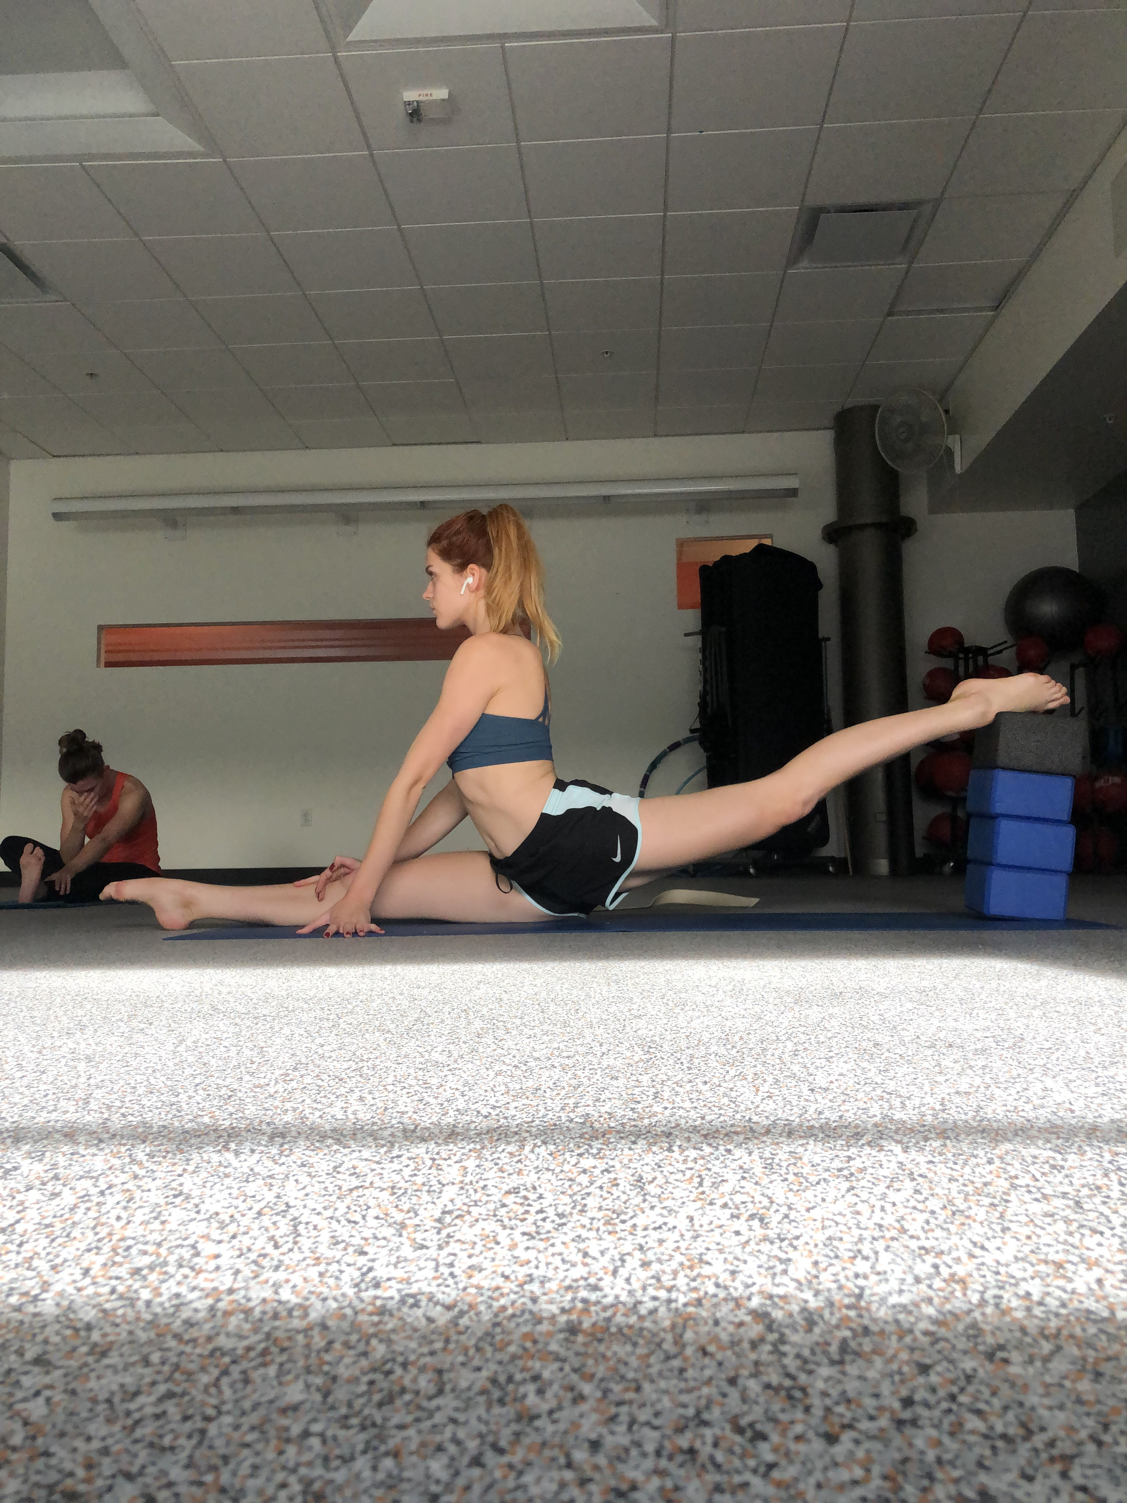
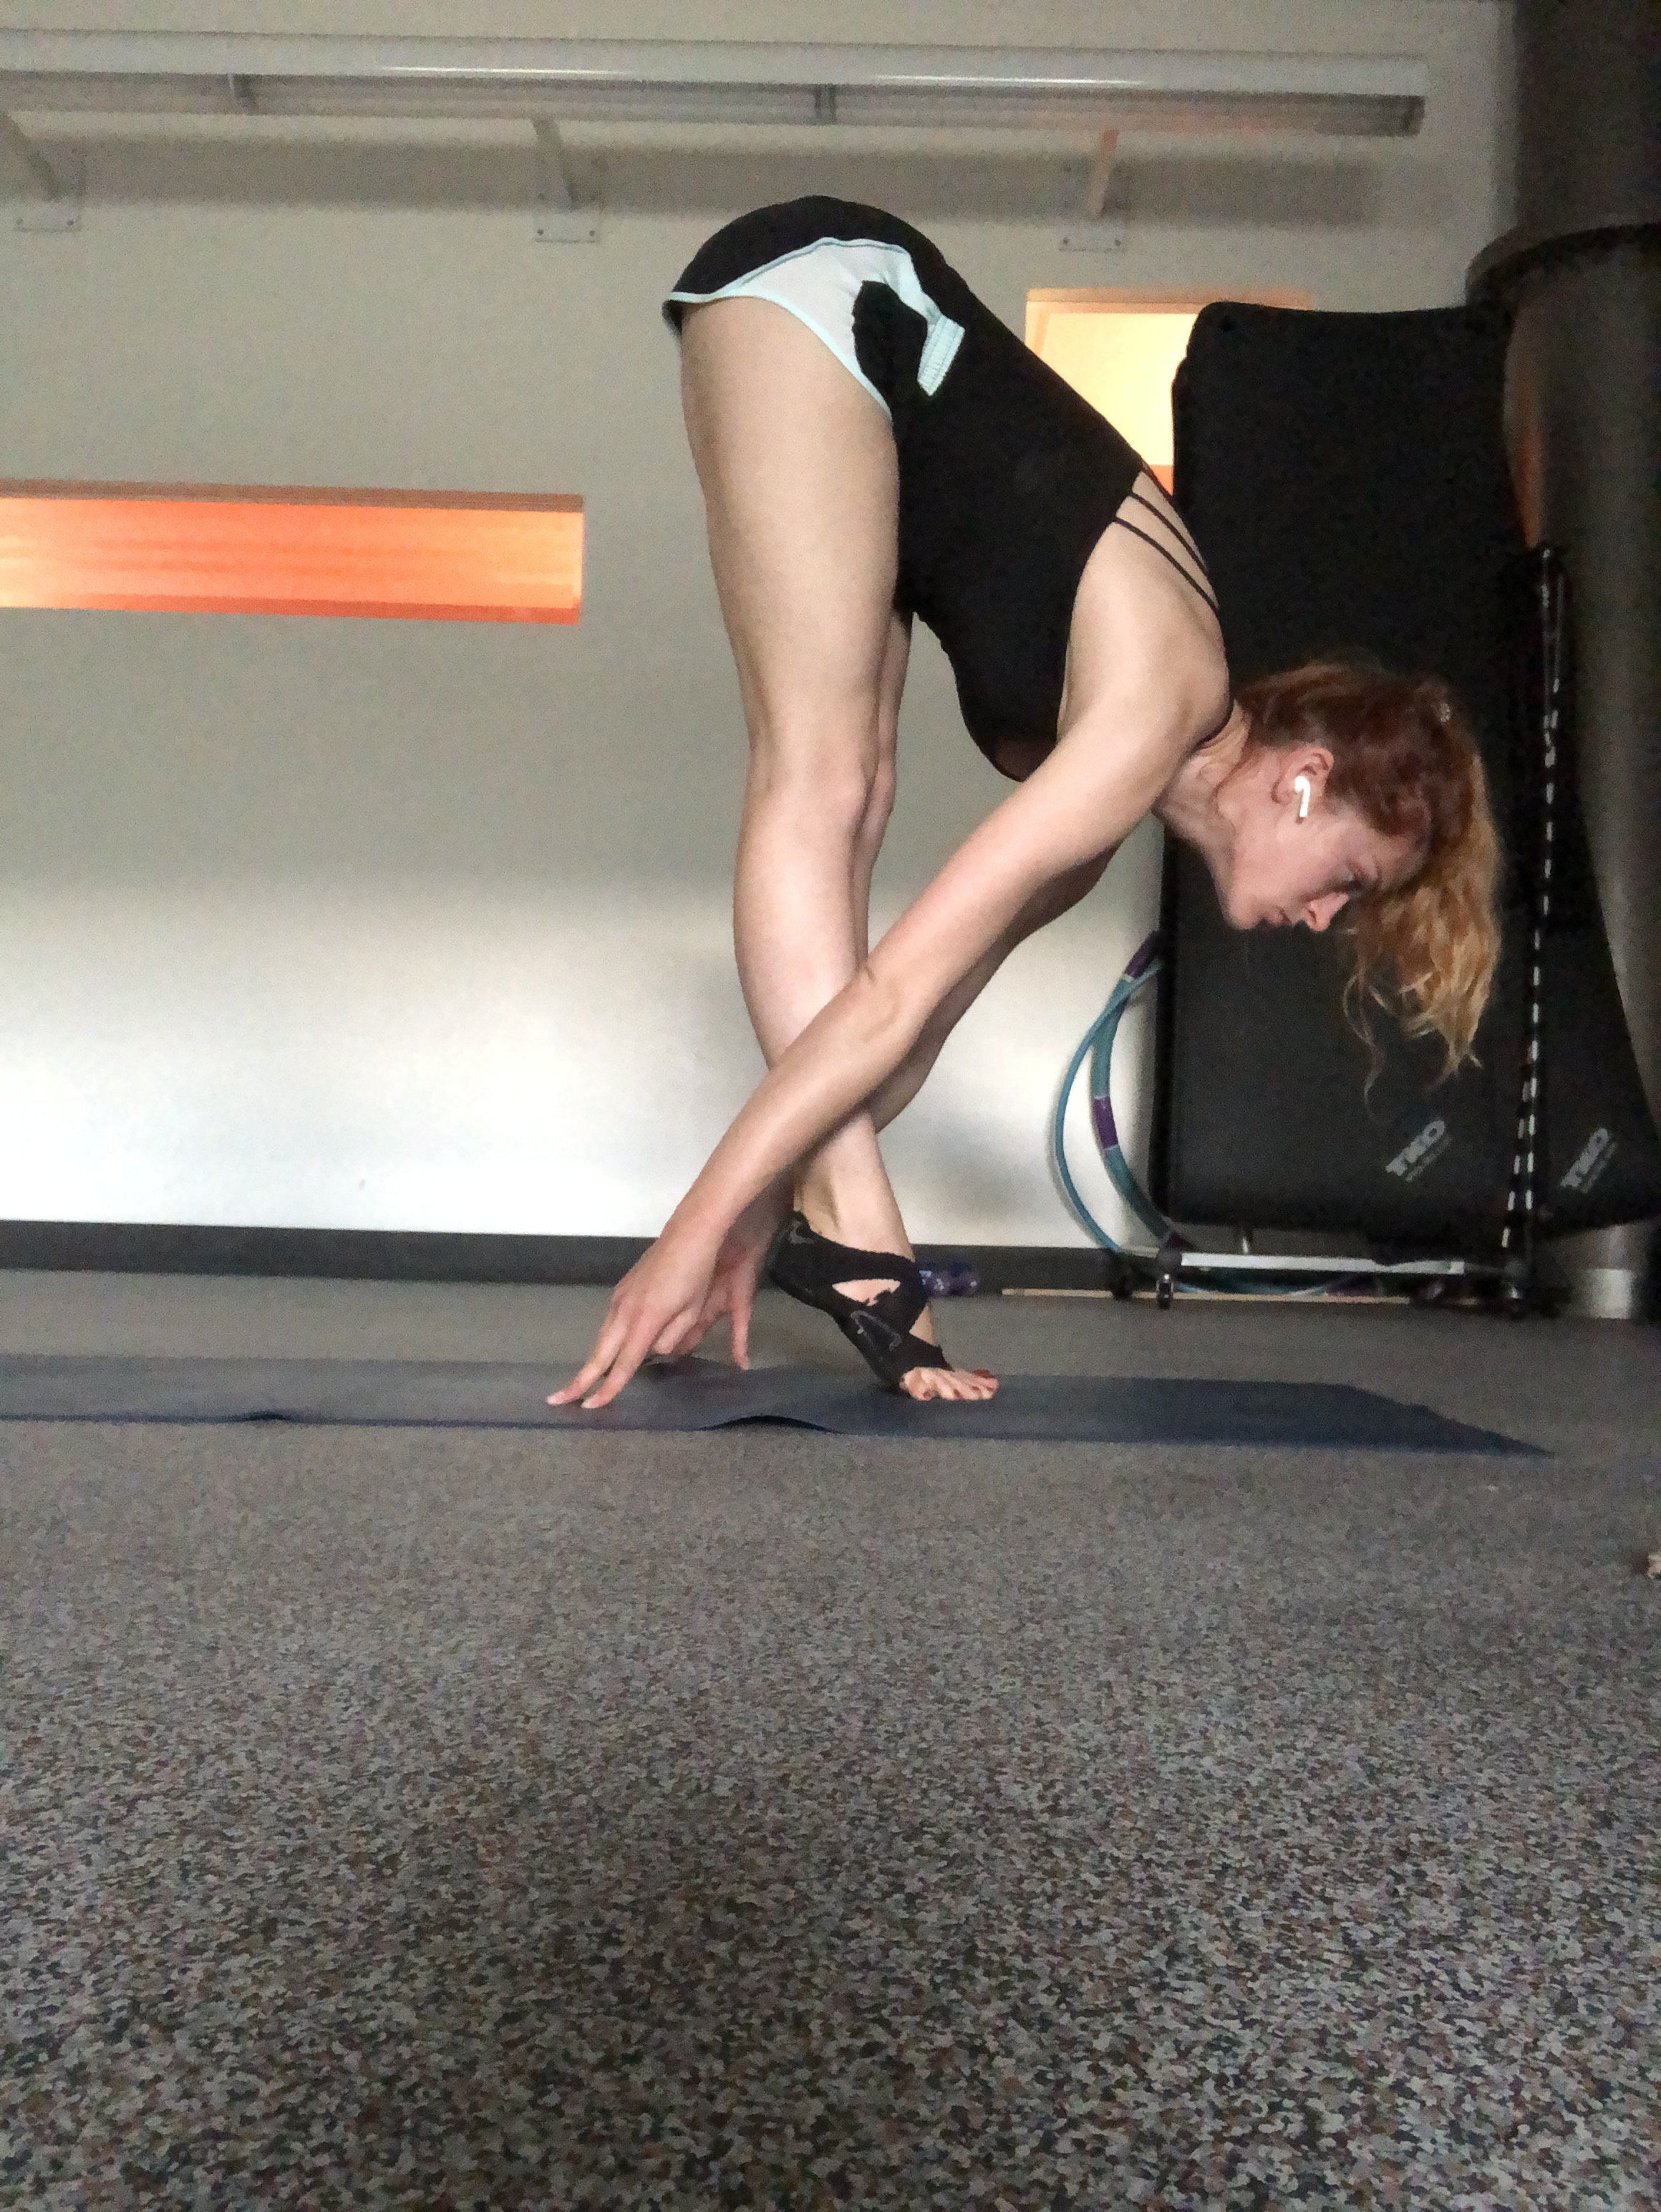

Slide 7
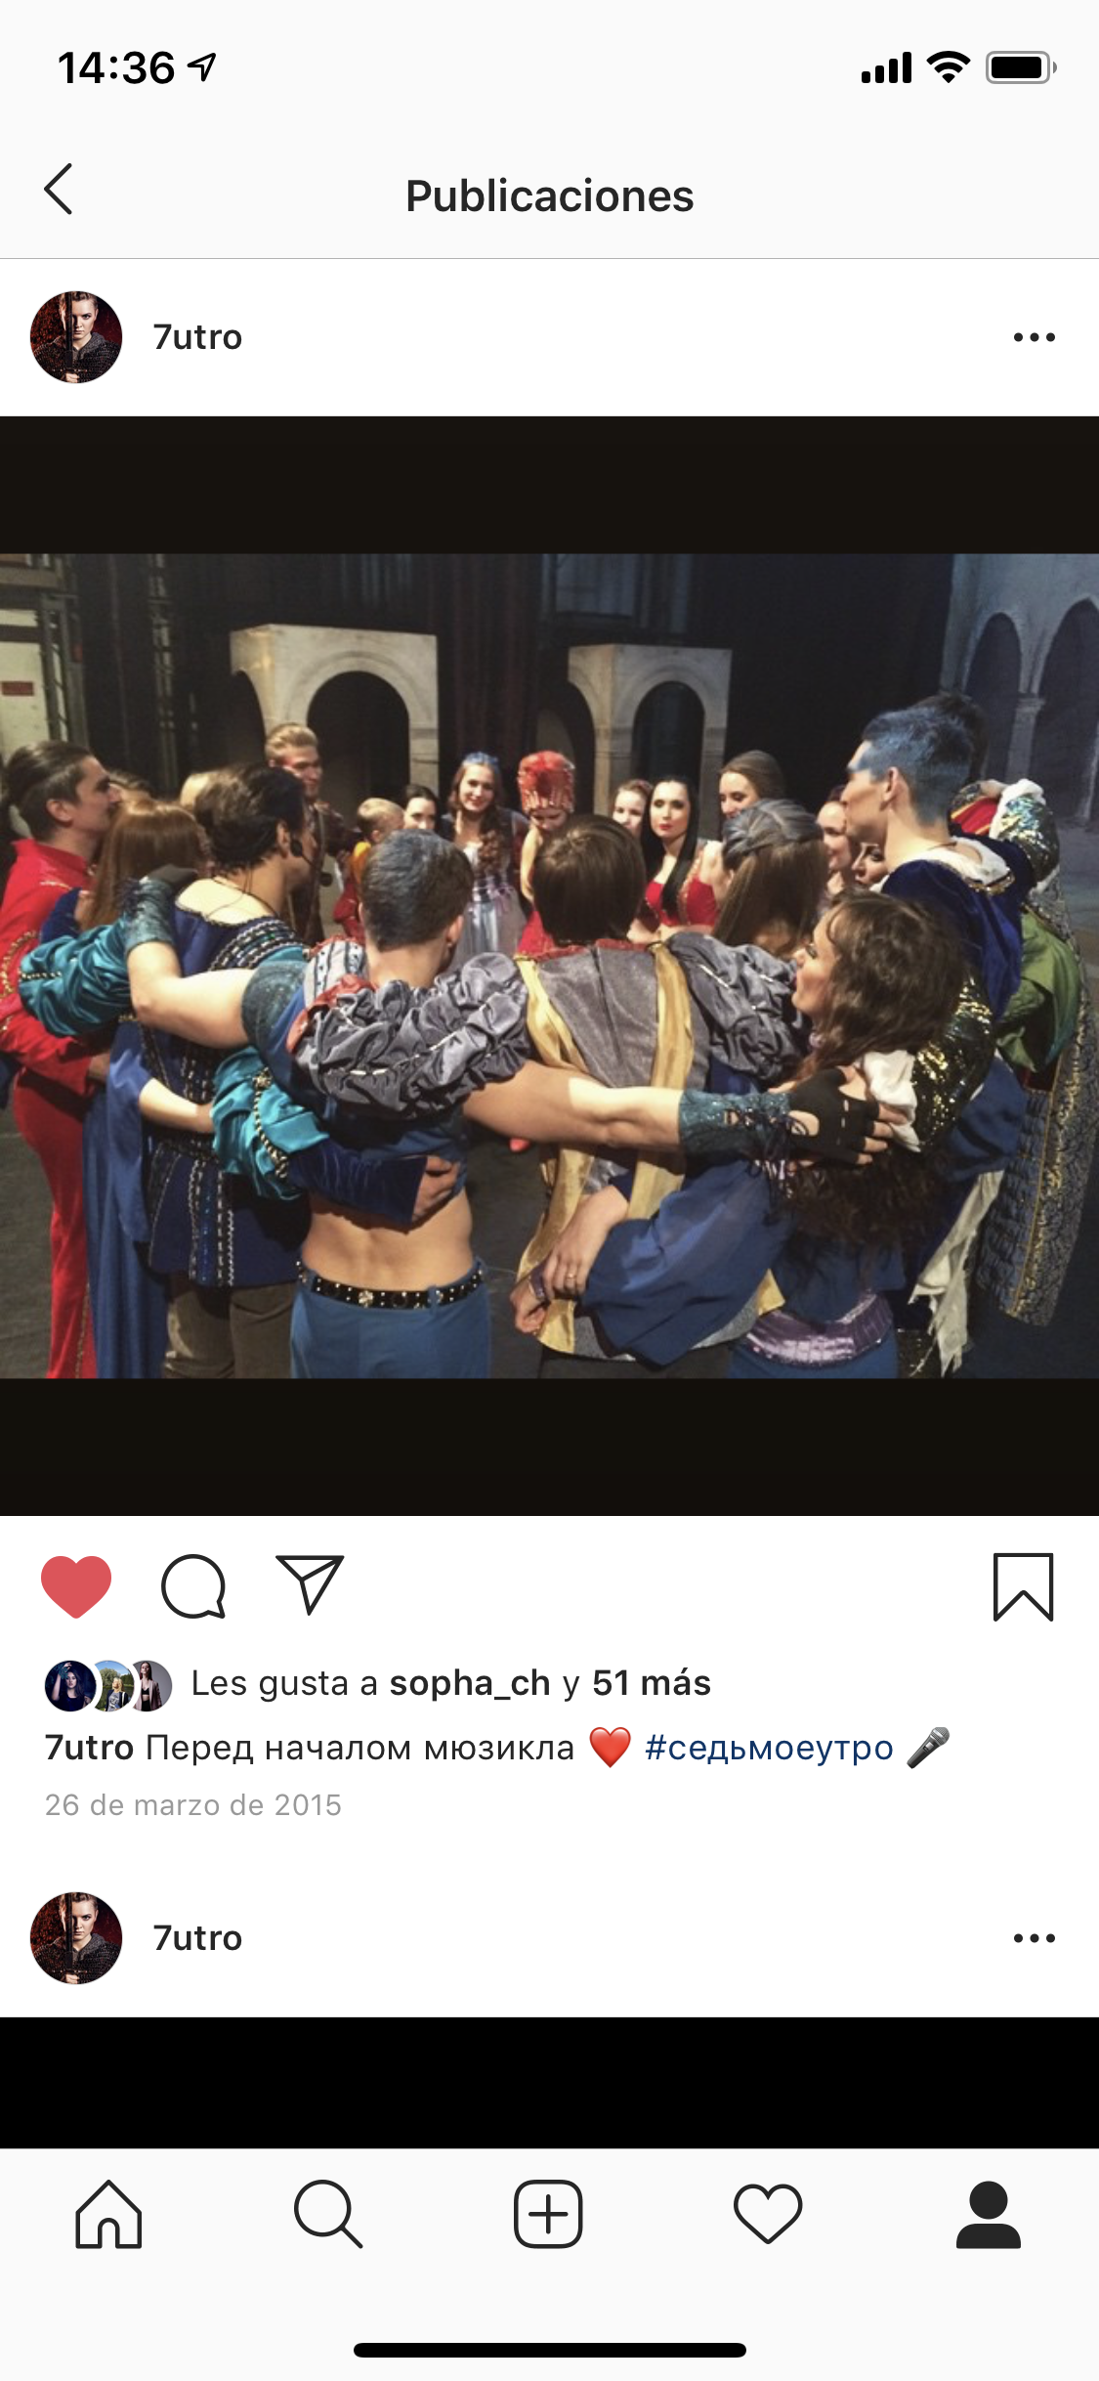
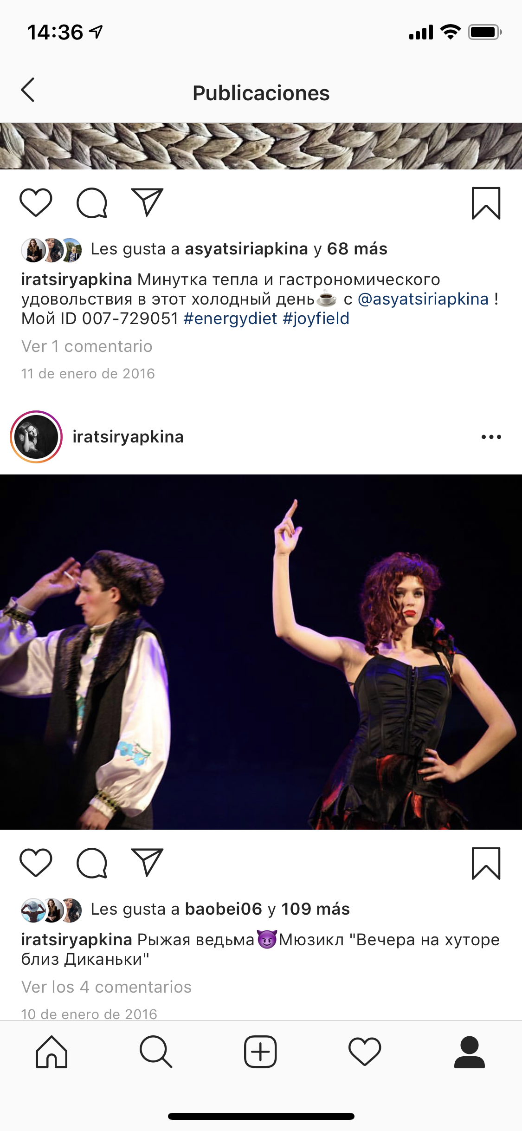

Slide 8
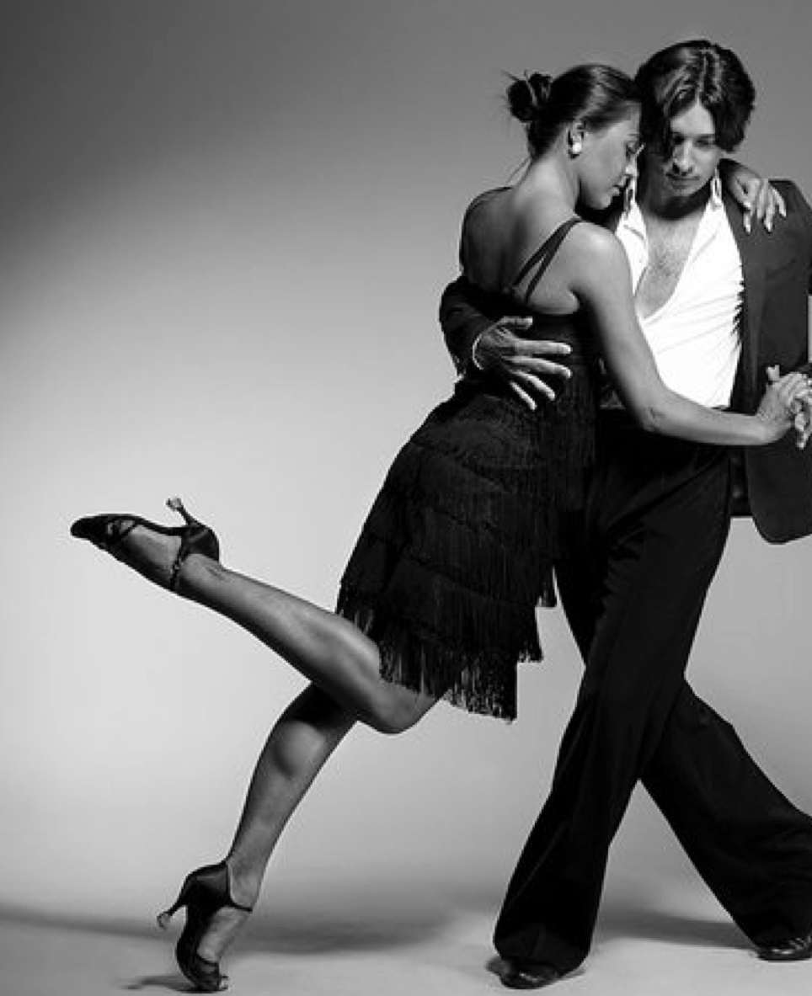
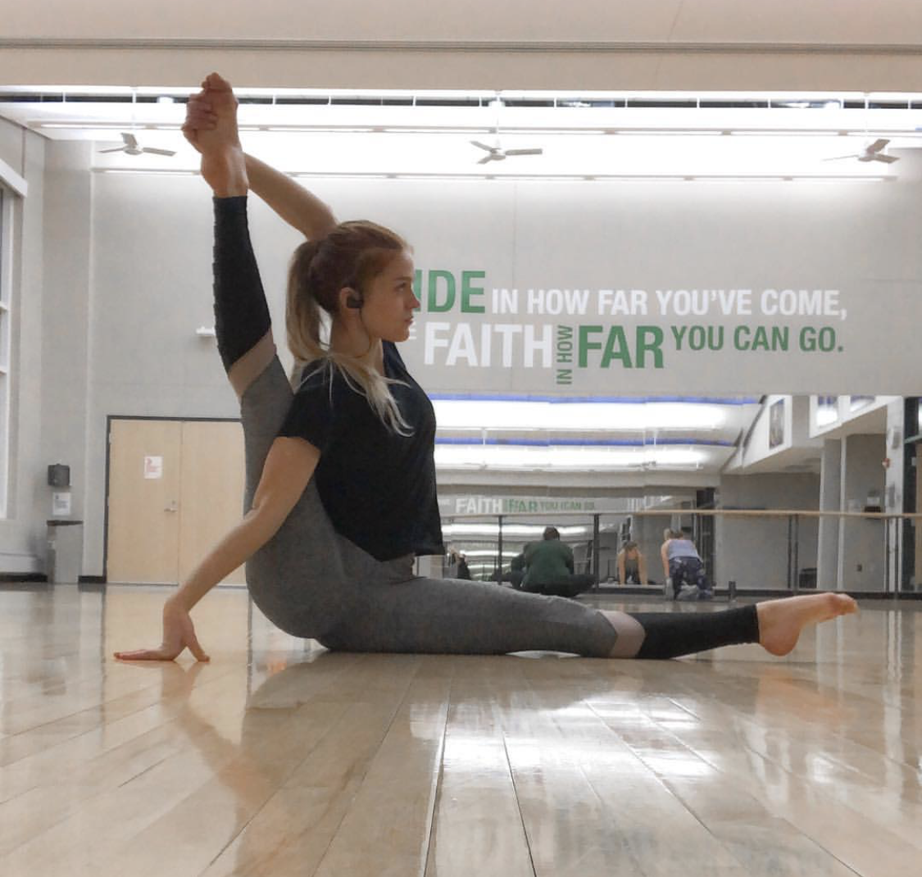
PERSONAL SUSTAINABILITY

Slide 9
PERSONAL SUSTAINABILITY
Mental work

Slide 10
PERSONAL SUSTAINABILITY
Mental work
Sport

Slide 11
PERSONAL SUSTAINABILITY
Art
Mental work
Sport

Slide 12
ARE YOU PERSONALLY SUSTAINABLE?

